Slide 1
ET TUTORIAL
Magnetic Circuits

Slide 2
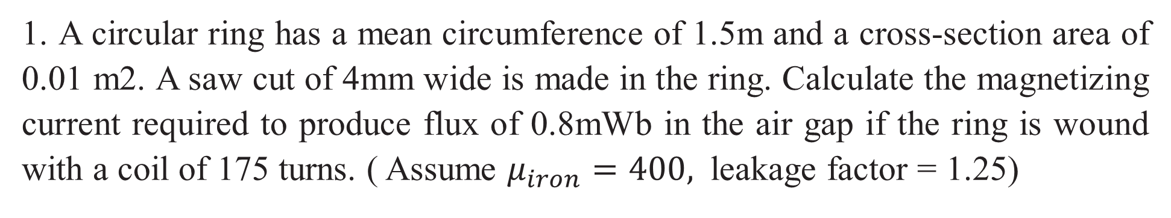
1. A circular ring has a mean circumference of 1.5m and a cross-section area of 0.01 m2. A saw cut of 4mm wide is made in the ring. Calculate the magnetizing current required to produce flux of 0.8mWb in the air gap if the ring is wound with a coil of 175 turns. ( Assume $μ_{iron}=400,$ leakage factor = 1.25)
Ans: 3.16 A

Slide 3
2. A cast steel electromagnet has an air gap length of 3mm and an iron path of length 40 cm. Find the number of ampere-turns necessary to produce a flux density of 0.7 Wb/m2 in the air-gap. Neglect leakage and fringing. Assume ampere-turns required for air gap to be 70% of the total ampere-turns.
Ans: 2387 AT

Slide 4
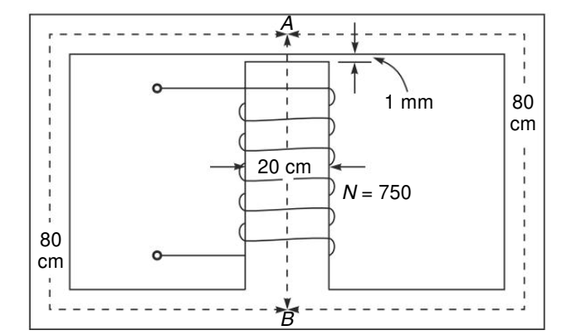

3. In the magnetic circuit shown in Fig. below the area of cross-section of the central limb is 12 cm2 and that of each outer limb (A to B) is 6 cm². A coil current 0.5 A produces 0.5 mWb in the air-gap. Find the relative permeability of the core material.
Ans:$μ_{r}=7604.2$

Slide 5
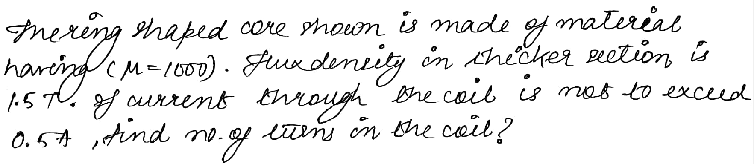
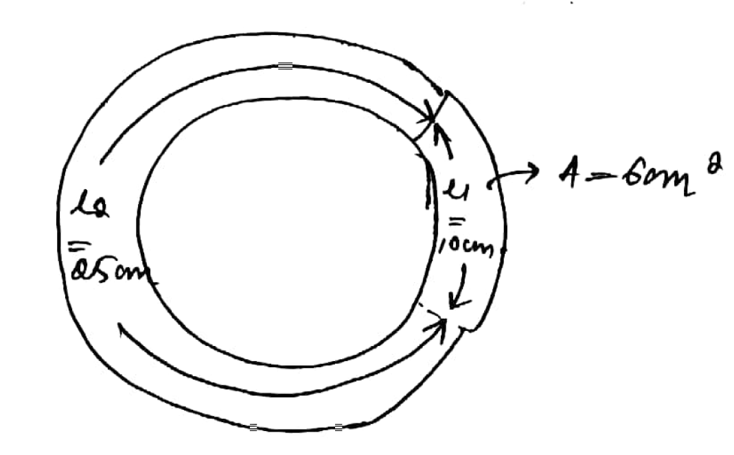

Ans:$1135 turns$

Slide 6
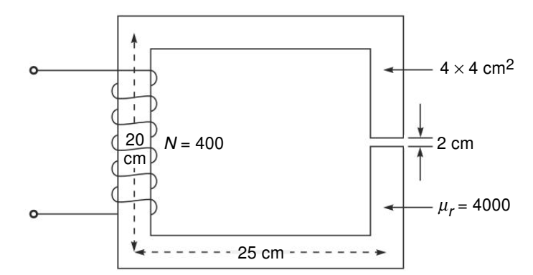
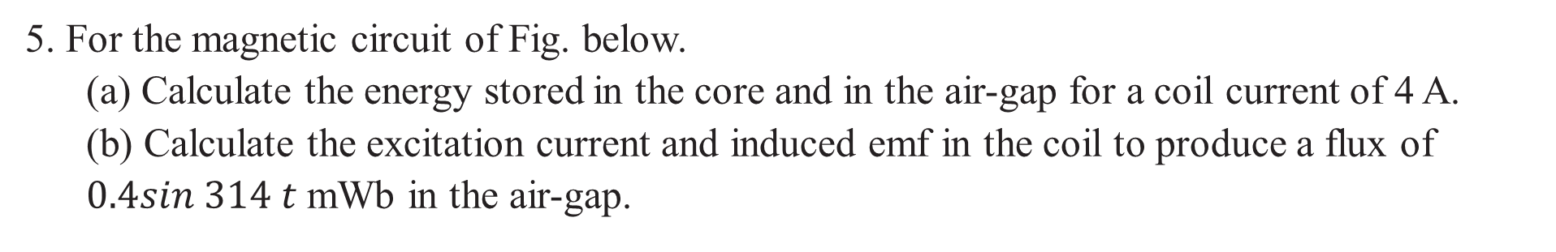
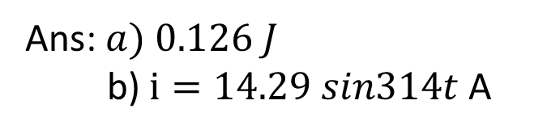
5. For the magnetic circuit of Fig. below.
(a) Calculate the energy stored in the core and in the air-gap for a coil current of 4 A.
(b) Calculate the excitation current and induced emf in the coil to produce a flux of $0.4sin 314 t$ mWb in the air-gap.
Ans: $a) 0.126 J$
b) $i=14.29 sin314t$ A

Slide 7
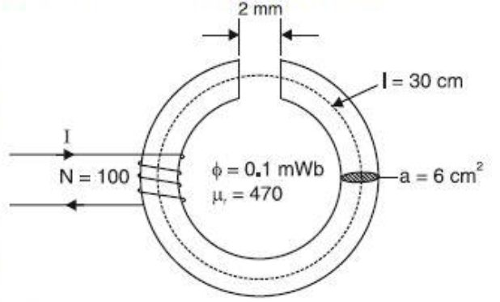
6. An iron ring of cross-section area 6cm2 is wound with a wire of 100 turns and has a saw cut of 2 mm. Calculate the magnetizing current required to produce a flux of 0.1mWb if the mean length of the magnetic path is 30cm and the relative permeability of iron is 470.
Ans: 3.51A

